Slide 1


Computing in Context: Fall 2024
Lecture 10|Intro to ML for Healthcare
Statistical brief overview
Dr Sarah Ashcroft-Jones | Mailman School of Public Health

Slide 2

Statistical brief overview
Section I : Introduction & Overview

Slide 3
What is Machine Learning?
Machine learning (ML) enables computers to learn from data.
teaching a computer to recognize patterns and make predictions
e.g. Netflix recommendation, Spotify shuffle, etc.
ML in healthcare works on improving diagnosis and personalized treatment
building predictions and suggestions based on Big Data in healthcare

Slide 4
Key Terms (before we begin!)
Data: Input variables like patient age, lab results.
Features: Attributes used for predictions (e.g., glucose levels).
Labels: Known outcomes (e.g., disease present or absent).

Slide 5
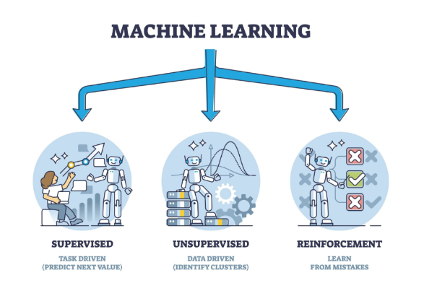

Slide 7
Learning Types in ML
Supervised Learning: Uses labeled data
(e.g., diagnosing a specific disease)
Unsupervised Learning: Finds patterns without labels
(e.g., patient segmentation/clustering).
Reinforcement Learning: Learns from outcomes to make decisions
(e.g., treatment recommendations).
Notes:
Supervised Learning: “Supervised learning is like teaching a student with flashcards. You provide the machine with examples where the correct answers (labels) are already known. For example, you might give it thousands of chest X-rays labeled as either 'healthy' or 'pneumonia.' The machine learns the patterns and predicts future cases.”
Example:
Predicting whether a patient has diabetes based on blood sugar levels, age, and other factors.
Unsupervised Learning: “Unsupervised learning is more like exploring a new city without a guide. Here, the machine looks at data and finds hidden patterns or groupings on its own. There are no labels provided.”
Example:
Clustering patients with similar symptoms into subgroups to identify new disease categories or treatment plans.
Reinforcement Learning: “Reinforcement learning is like training a dog with rewards. The machine makes decisions and learns by trial and error, receiving rewards or penalties based on the outcome. Over time, it learns the best course of action.”
Example:
Optimizing personalized treatment plans by learning from patient responses to different therapies.
“To visualize these, imagine teaching three types of learners:
The first (supervised) is taught with answer keys.
The second (unsupervised) explores and groups things on their own.
The third (reinforcement) learns through rewards and consequences.”
Can you think of a healthcare scenario where finding hidden patterns without knowing the labels might be useful?”

Slide 8
Why Healthcare Needs Machine Learning
Big Picture:
Rapid analysis of large datasets for faster, more accurate decisions.
Potential to improve patient outcomes and reduce healthcare costs.
Down in the details:
Faster Diagnoses: Analyze medical images in seconds.
Predictive Analytics: Forecast disease progression.
Personalized Medicine: Tailor treatments based on genetics.
Operational Efficiency: Optimize hospital workflows.

Slide 9
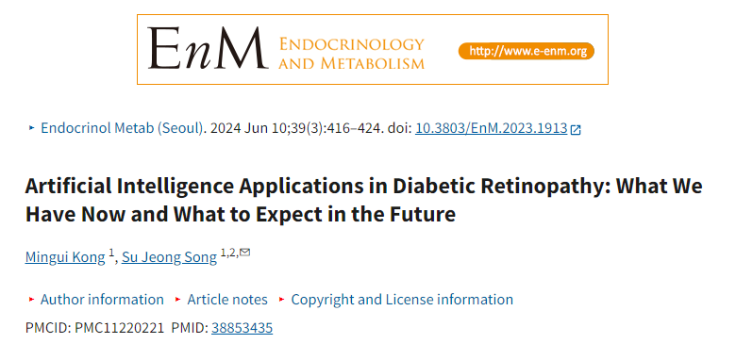
Real world impact
https://pmc.ncbi.nlm.nih.gov/articles/PMC11220221/#:~:text=Currently%2C%20AI%20applications%20in%20DR,microvascular%20changes%2C%20as%20previously%20mentioned.
Notes:
more than 300 research papers have been published on the diagnosis of Diabetic Macular Edema DME using AI, demonstrating high levels of accuracy. Sensitivity and specificity rates exceed 95%, and accuracy surpasses 0.98 when employing OCT and/or fundus photographs for AI-based DME detection

Slide 10
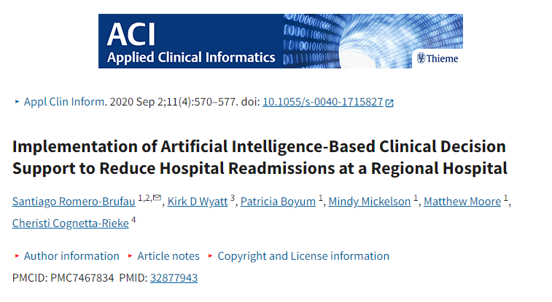
Real world impact
https://pmc.ncbi.nlm.nih.gov/articles/PMC7467834/#:~:text=Clinical%20Relevance%20Statement,period%20(%20p%20%3C%200.001).
Notes:
The AI tool combined clinical and nonclinical data to predict a patient's risk of hospital readmission within 30 days using machine learning.
2,460 hospitalizations assessed using the tool, 611 were designated by the tool as high risk. Sensitivity and specificity for risk assignment were 65% and 89%, respectively. Over 6 months following implementation, readmission rates decreased from 11.4% during the comparison period to 8.1% ( p < 0.001). After accounting for the 0.5% decrease in readmission rates (from 9.3 to 8.8%) at control hospitals, the relative reduction in readmission rate was 25% ( p < 0.001).

Slide 11
Statistical brief overview
Section II : How ML Works

Slide 12
ML Workflow in Healthcare: Overview
Data Collection: EHR, imaging, genomics.
Data Preprocessing: Cleaning, normalization.
Model Training: Feed data into the algorithm.
Evaluation: Validate on new data.
Deployment: Integration into clinical practice.

Slide 13
ML Workflow in Healthcare: Rule 1
“Garbage in Garbage out”

Slide 14
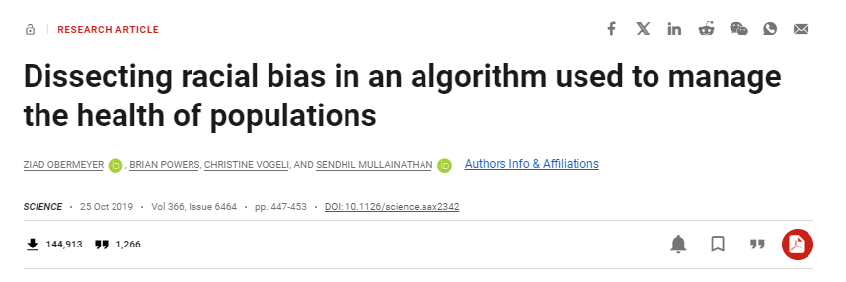
Rule 1: Garbage in Garbage out
https://www.science.org/doi/full/10.1126/science.aax2342
Notes:
AI algorithms used health costs as a proxy for health needs and falsely concluded that Black patients are healthier than equally sick white patients, as less money was spent on them.

Slide 15
ML Workflow in Healthcare: Rule 2
“All models are wrong, but some are useful” George Box

Slide 16
Rule 2: All models are wrong
Decision Tree: A simple, intuitive algorithm that splits data based on feature values into branches to make predictions.
Random Forest: An ensemble of multiple decision trees to improve accuracy and reduce overfitting. It averages the predictions from many trees for a more robust result.
CNNs: A type of deep learning algorithm specialized in processing grid-like data such as images. CNNs use layers of filters to automatically detect patterns and features in images.
Notes:
Convolutional Neural Networks (CNNs)

Slide 17
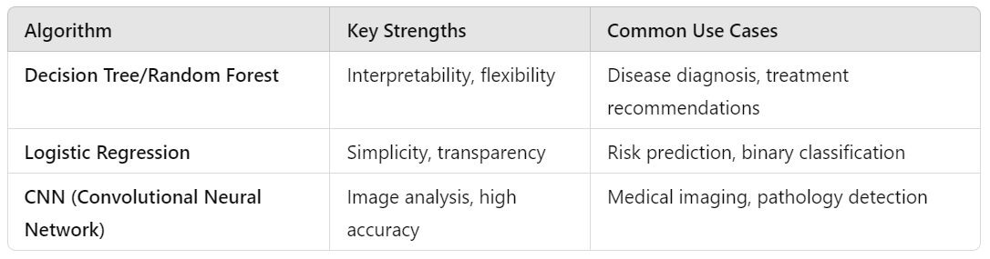
Rule 2: Some models are useful

Slide 18
Statistical brief overview
Section III : Worked Example

Slide 19
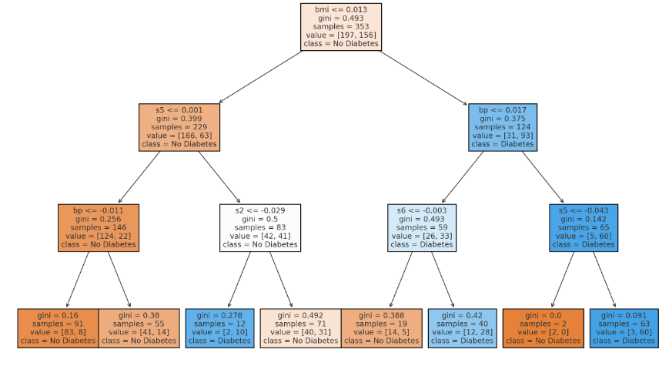
Decision tree classifier in Python
Notes:
Nodes: Each node represents a decision point based on a feature (e.g., "BMI").
Thresholds: Splits occur based on feature values (e.g., BMI ≤ 0.03).
Gini: Indicates the impurity of the node, with lower values being more pure.
Samples: Shows the number of samples in the node.
Class Distribution: Represents the proportion of "No Diabetes" (class 0) and "Diabetes" (class 1) in each node.

Slide 20
Core ingredients of a “decision”: Splitting Criterion
Gini Impurity: Measures how often a randomly chosen element would be incorrectly labeled if randomly classified based on the distribution of labels in the dataset.
Entropy (Information Gain): Measures the randomness in the dataset. The algorithm selects splits that maximize Information Gain, which is the reduction in entropy after the split.
Key Issue:
Instability: Small changes in data can lead to different splits and different trees.

Slide 21
Core ingredients of a “decision”: Stopping Criteria
max_depth: Limits the depth of the tree to prevent overfitting.
min_samples_leaf: The minimum number of samples that must be present in a leaf node.
Key Issue:
Overfitting: Decision trees can easily overfit to training data, especially if the tree is too deep.

Slide 22
Example in Python:

Slide 23
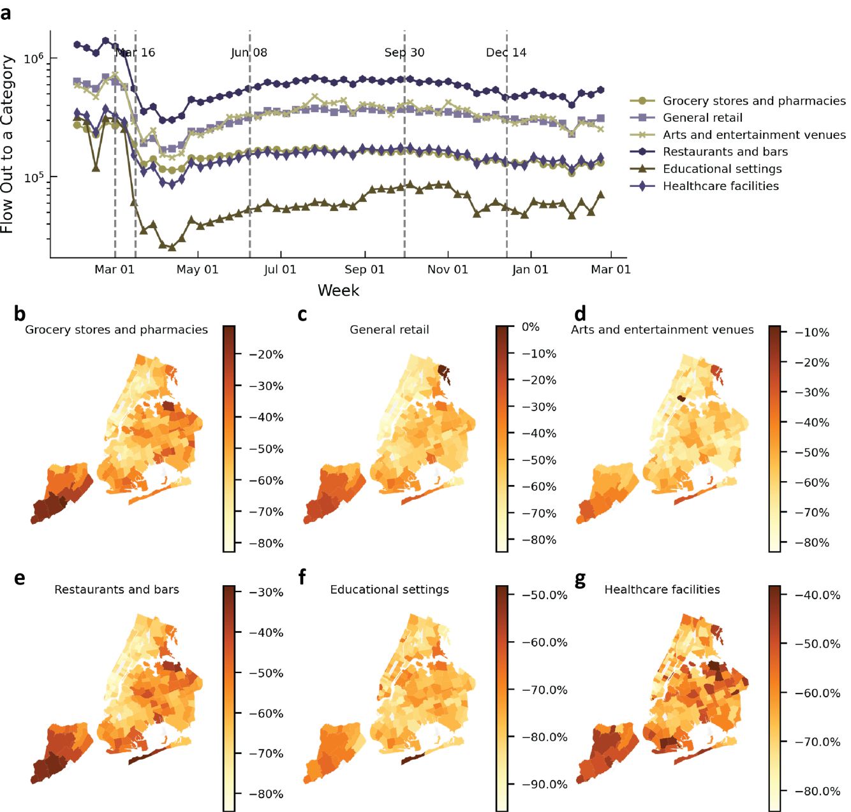
Example in my work:
Human mobility in times of crisis:
- Pandemic case study
Across NYC zipcodes and boroughs
Who went where, when, and why?
Behavioral measures and agency

Slide 24
Example in my work:
Random Forests:
ML algorithm that combines multiple independent decision trees, each trained on a random subset of the data.
At each split, randomly choose a subset of features to consider (no overfit)
When making a prediction, aggregate the results from all trees by taking the majority vote (classification) or averaging (regression)
N.B: Provides a built-in mechanism to identify the most important features in the data based on how frequently they are used in the decision trees

Slide 25
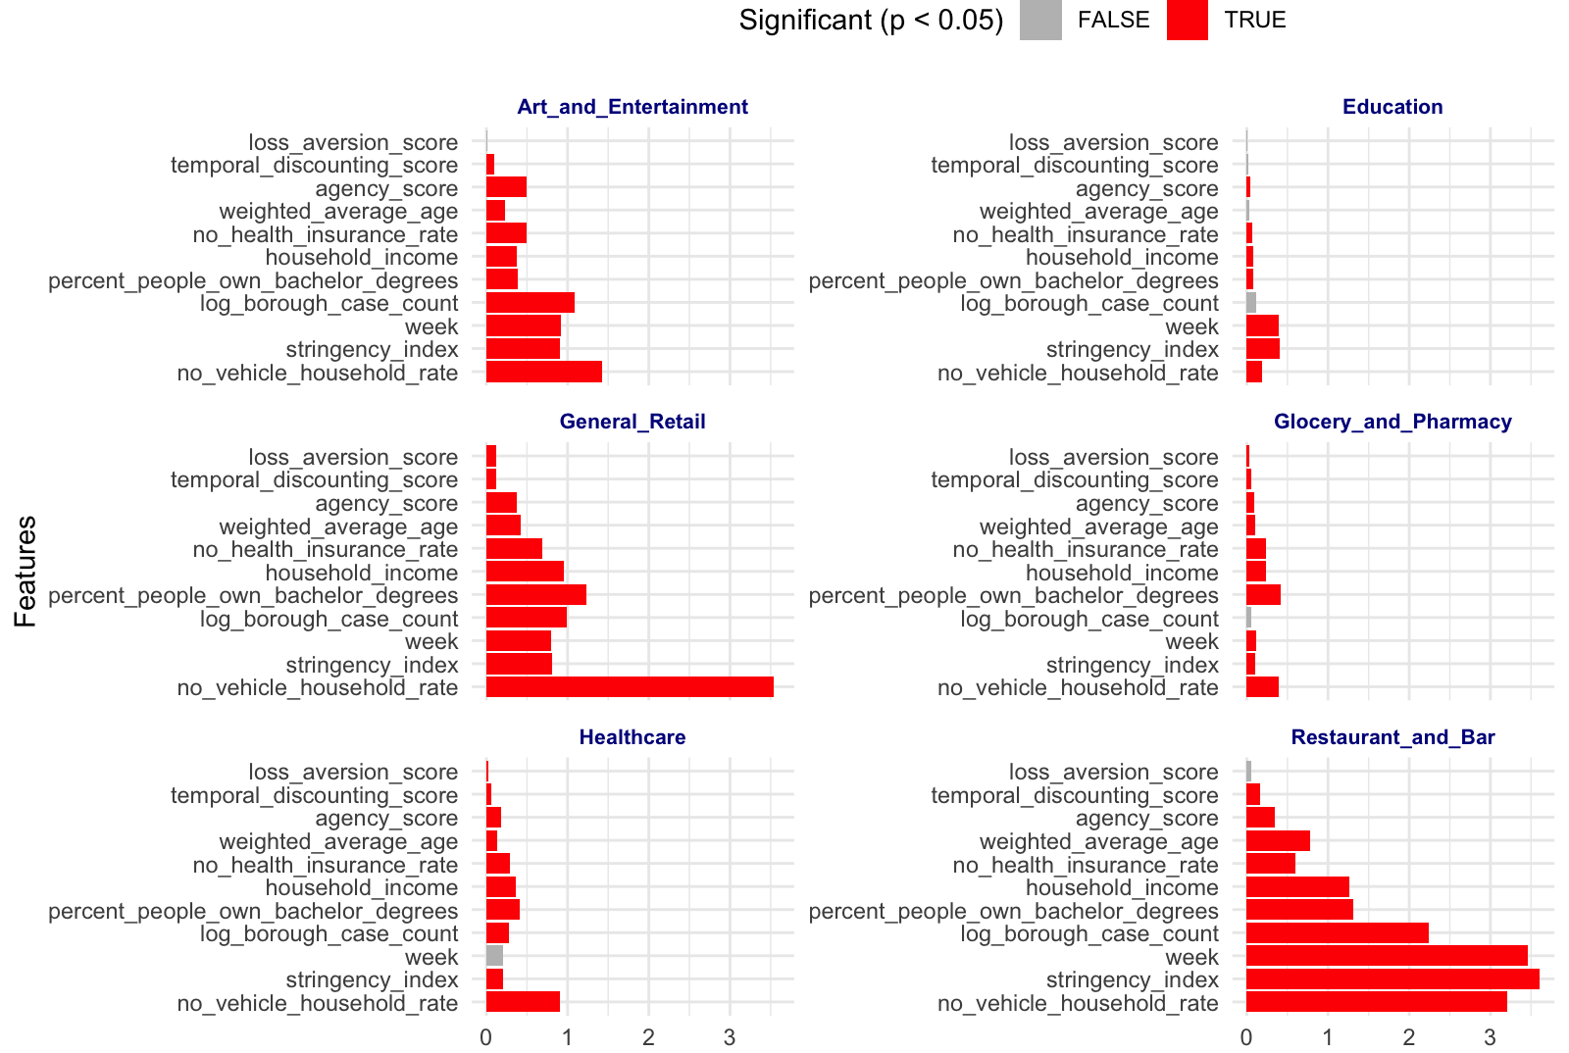
Example in my work

Slide 26
Statistical brief overview
Section IV : Discussion

Slide 27
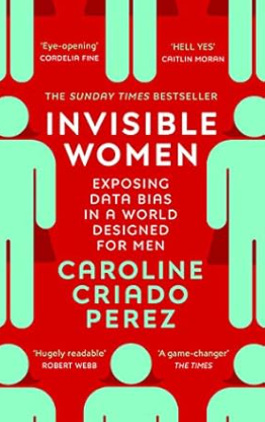
Discussion points:
How could ML be applied in underserved healthcare systems?
What ethical concerns resonate most with you?
Where can you imagine bias emerging in ML models?

Slide 28
Free Resources (aka you don’t need a paid bootcamp)
Courses:
AI and Medical Diagnosis Coursera (applied, light touch),
ML Engineering (more abstract and heavy),
Books:
Little book of ML (short and sweet),
Big Book of ML (advanced),
DeepLearning (overview),
d2l (comprehensive DL overview),
General/Misc:
LLMs (cool website for explanatory visualizations of LLMs and genAI)

Slide 29
Statistical brief overview
Questions?

